Slide 1
Contours in OpenCV
-Shalmali Sen

Slide 2
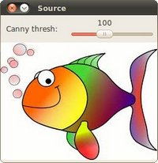
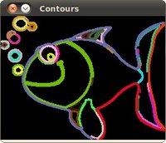
We have two functions in openCV-
findContours – to find the contours or outlines of a given image.
drawContours – to draw the detected contours or outlines.

Slide 3
Contours are curves joining all the continuous points along the boundary, having same color or intensity. The contours are a useful tool for shape analysis and object detection and recognition.
For better accuracy, we use binary images. So before finding contours, apply threshold or canny edge detection.

Slide 4
findContours Parameters
void findContours(InputOutputArray image, OutputArrayOfArrays contours, OutputArray hierarchy, int mode, int method, Point offset=Point())
image-has to be a 8-bit single, channel image, the image is a binary image
contours – All the detected contours. Each contour is stored as a vector of points.
hierarchy – It’s a optional output vector, contains information about the image topology.

Slide 5
mode – decides what types of contours will be detected.Ex- CV_RETR_EXTERNAL, CV_RETR_LIST,CV_RETR_CCOMP
method –Contour approximation method
It specifies which all coordinates of the boundary are stored.
CV_CHAIN_APPROX_NONE stores absolutely all the contour points
CV_CHAIN_APPROX_SIMPLE compresses the contour
by removing all redundant points, thereby saving memory
offset –It’s a optional field.

Slide 6
drawContours Parameters
void drawContours(InputOutputArray image, InputArrayOfArrays contours, int contourIdx, const Scalar& color, int thickness=1, int lineType=8, InputArray hierarchy=noArray(), int maxLevel=INT_MAX, Point offset=Point() )
image – Destination image.
contours – All the input contours.
contourIdx – If it is negative, all the contours are drawn.
color – Color of the contours.
thickness – Thickness of lines the contours are drawn with. If it is negative the contour interiors are drawn.

Slide 7
lineType – Line connectivity.
hierarchy – Optional information about hierarchy.
maxLevel – Maximal level for drawn contours.
0-only the specified contour is drawn.
1- the function draws the contour(s) and all the nested contours.
2- the function draws the contours, all the nested contours, all the nested-to-nested contours, and so on. This parameter is only taken into account when there ishierarchy available.
offset – Optional contour shift parameter.
contour – Pointer to the first contour.
externalColor – Color of external contours.
holeColor – Color of internal contours (holes).

Slide 8
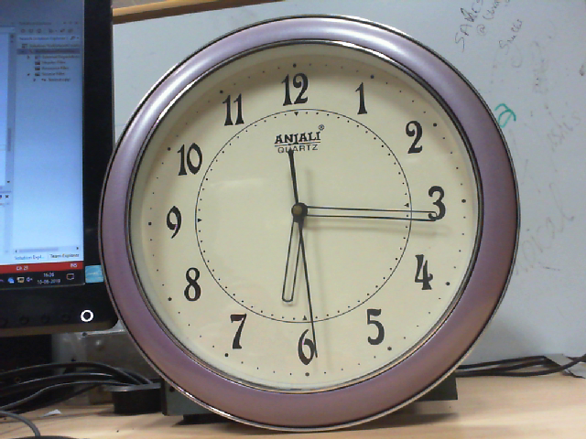
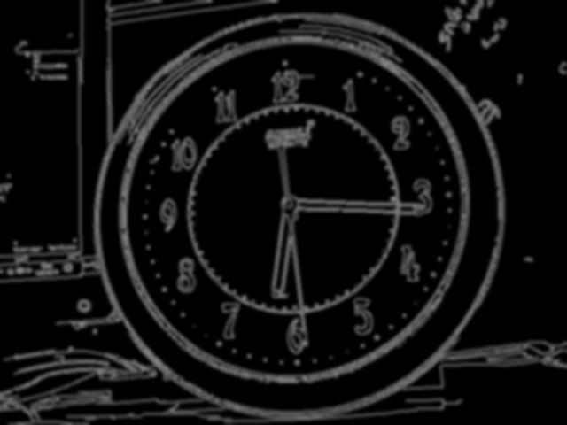
Detecting time from a clock-project
The image is captured using webcam
The image is converted to grayscale, then edge detection using canny method is done, then the image is blurred

Slide 9


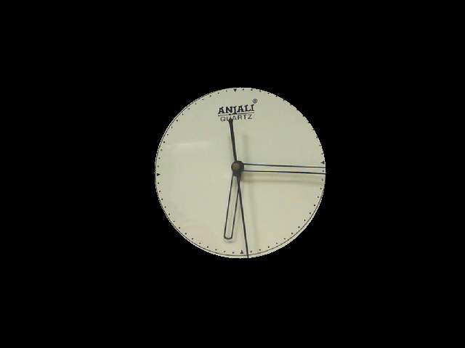
The inner circle is detected

Slide 10
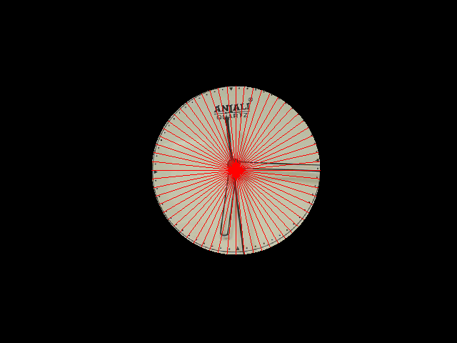

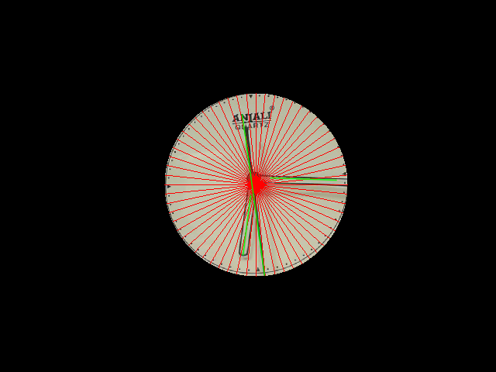
Sector are drawn on the image.
The hands of the clock are detected

Slide 11
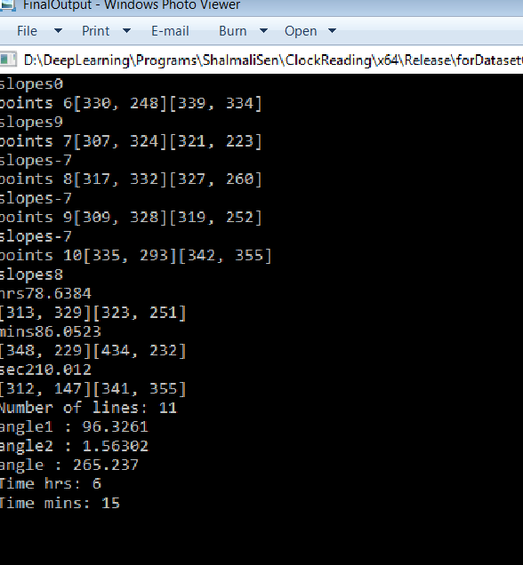
Final output

Slide 12
Thank You

